Slide 1



Legacy of microbial composition matters in simulating climate-driven litter decomposition
Bin Wang
(wangb@ornl.gov; ORNL)
Steven Allison
(allisons@uci.edu; UC Irvine)

Slide 2
Microbial composition matters in litter decomposition
Tremendous diversity and complexity make it exciting to study composition-functioning relationships in microbiomes.
Various approaches at varying scales were applied:
-> manipulation of community composition in lab (e.g., Yu et al. 2019)
-> lab incubations of natural communities (e.g., Pascual-García and Bell 2020 )
-> reciprocal transplant in field-manipulated plots (e.g., Allison et al. 2013)
-> reciprocal transplant in natural habitats (e.g., Glassman et al. 2021)

Slide 3
We do not yet know why composition matters!
Conceptual challenge
Methodological barrier
-> The ‘Hierarchical Concept’
(Lavelle et al. 1993; Aerts 1997)
-> Proved to be a reasoning fallacy(Bradford et al. 2017 NEE)
-> High functional redundancy (Allison and Martiny 2012 PNAS)
-> Taxonomy-based approach not revealing
We do not appreciate microbial composition in soil biogeochemical modelling

Slide 4
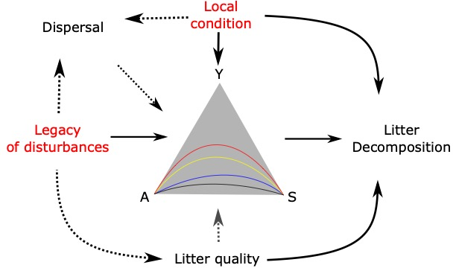
Hypothesis: coordinated changes in community traits can offer a unifying explanation of community-function relationships
Y: Yield
A: resource Acquisition
S: Stress tolerance
Malik et al. 2020 ISME

Slide 5
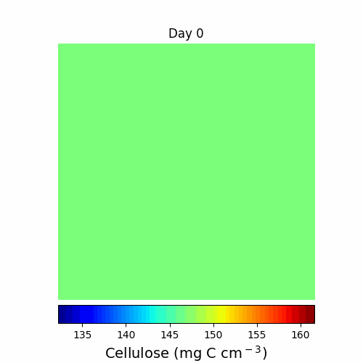
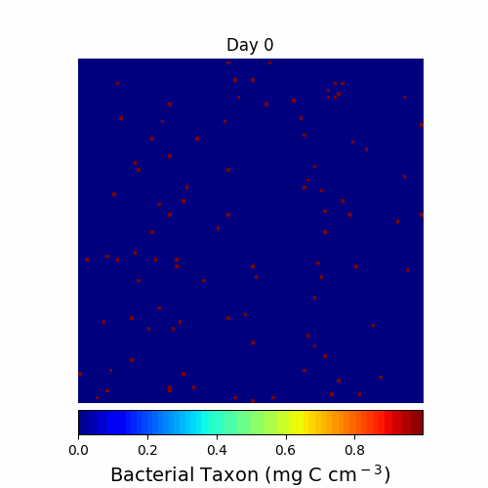

DEMENTpy
A trait- & individual-based microbial systems modelling framework
https://github.com/bioatmosphere/DEMENTpy
Wang & Allison 2021 Ecosphere
Wang & Allison 2019 Soil Biology and Biochemistry

Slide 6
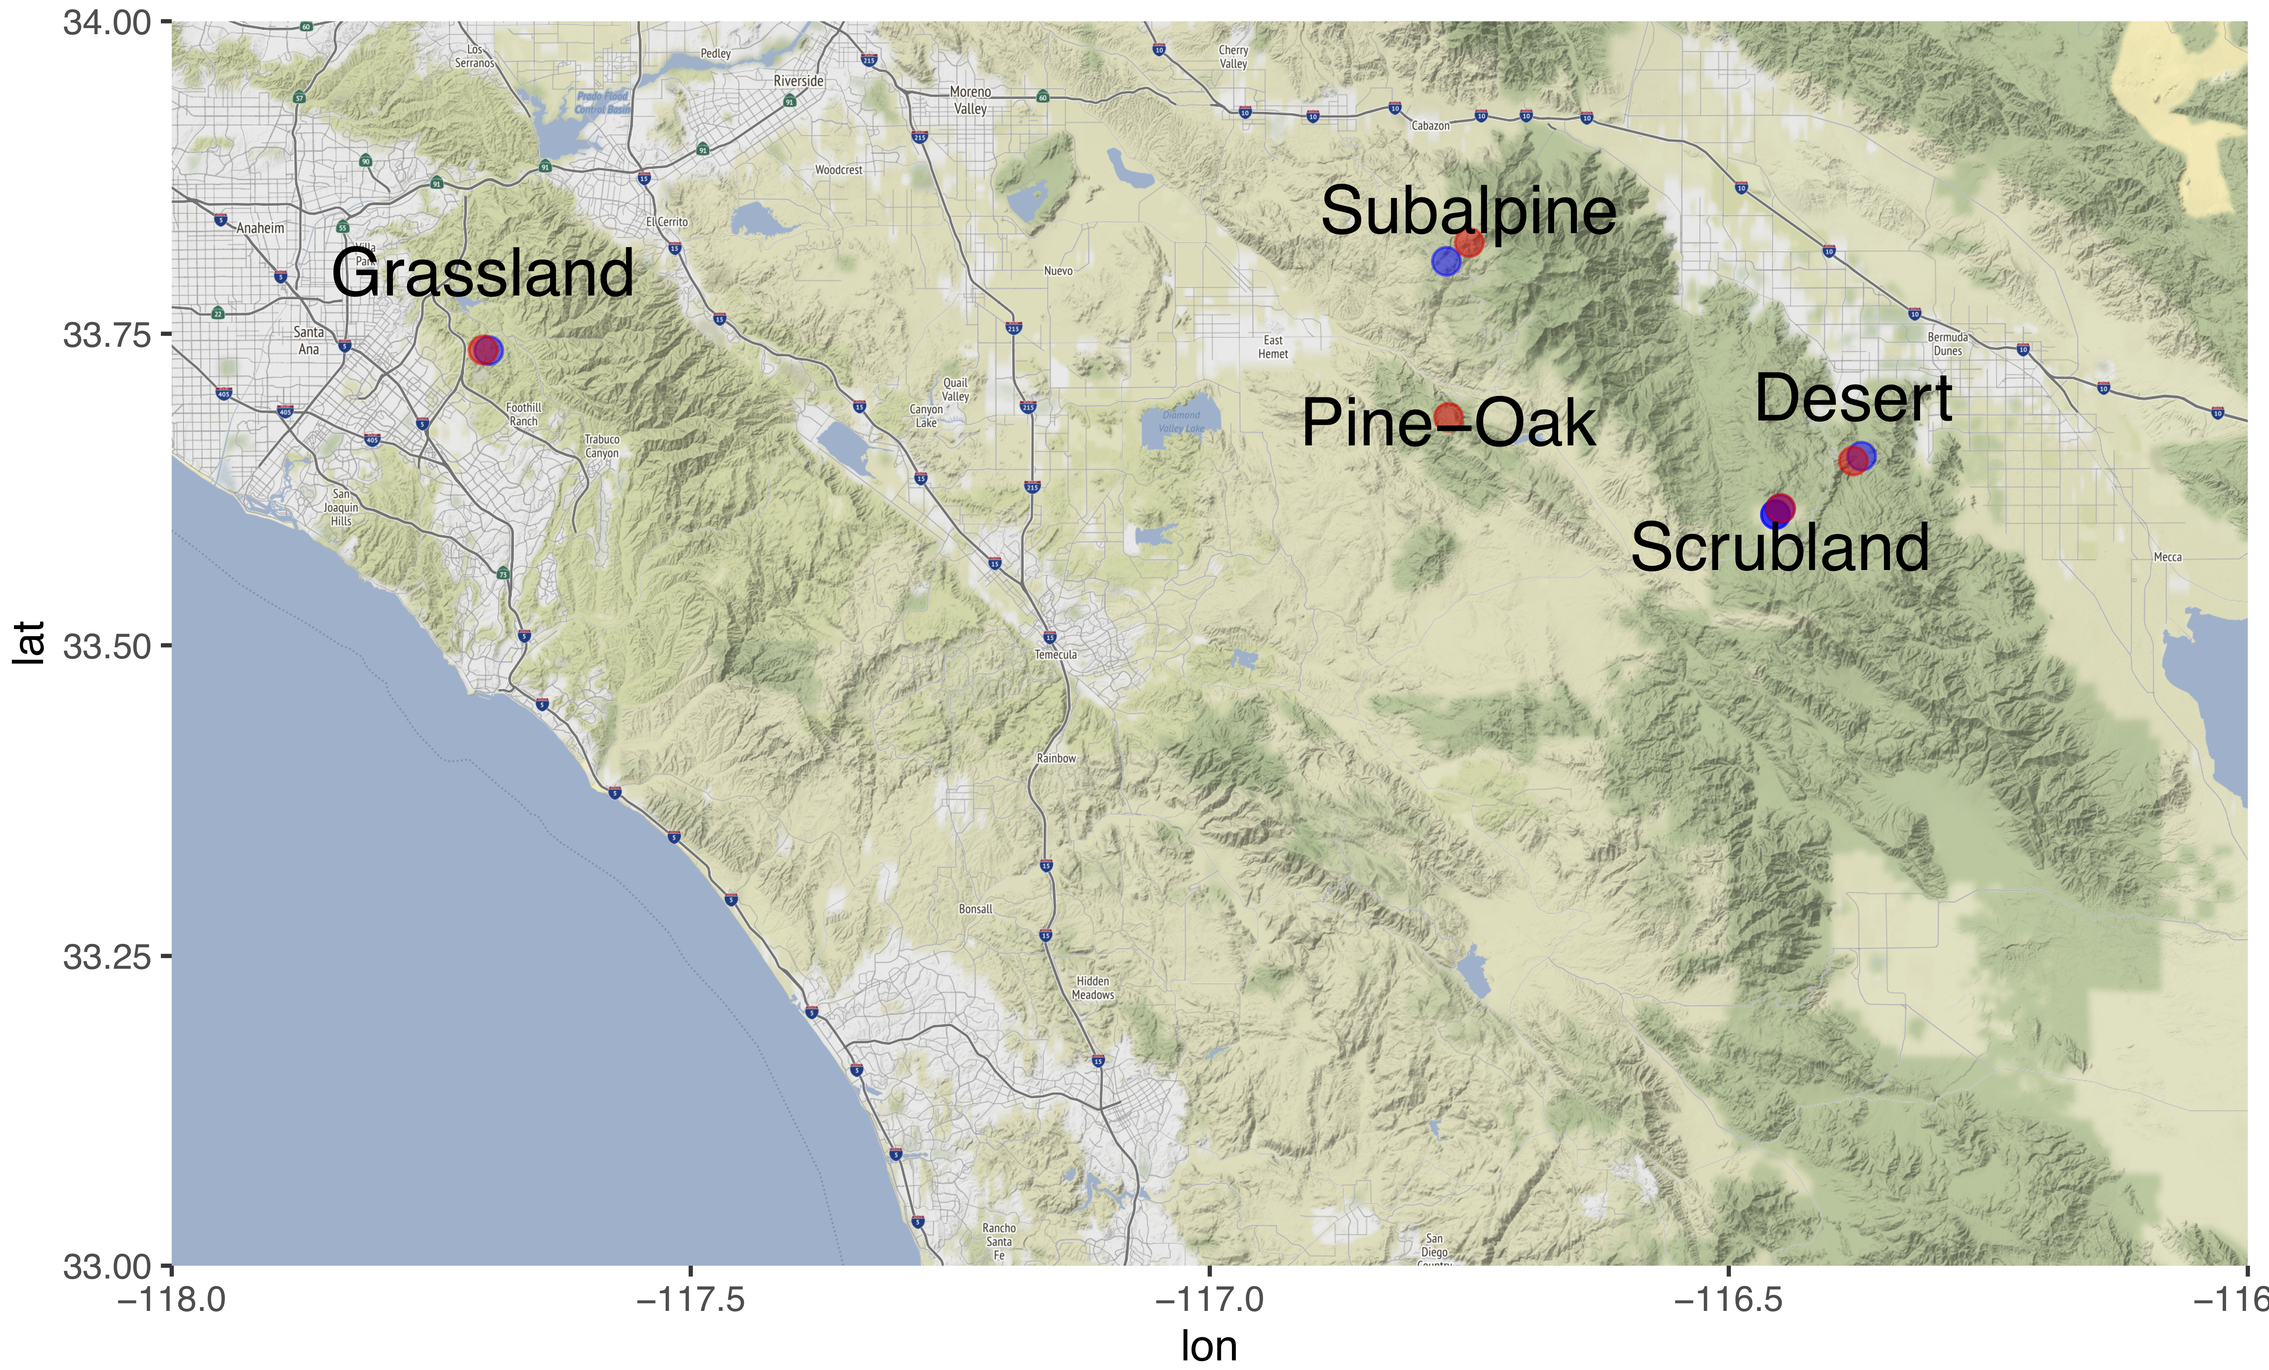
Reciprocal transplant simulations across a climate gradient in Southern California
Location of sites
Transplant Communities
Spanning nearly 2,000 m of elevation and 15 °C of soil temperature
Glassman et al. 2018 PNAS
Wang and Allision (in preparation)

Slide 7
Impacts of microbial compositional legacy on decomposition is context-dependent
Wang and Allison (in preparation)

Slide 8
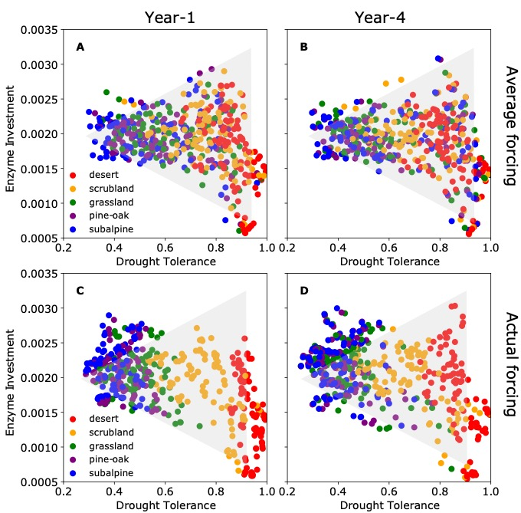
Communities across the gradient confined to a YAS space
Wang and Allison (in preparation)

Slide 9
Decomposition can be explained with two community traits

Slide 10
A unifying framework of predicting microbial litter decomposition empirically?
Need to confront a challenge of measuring these composite traits!

Slide 11
Take-home messages
Legacy of microbial composition matters!
A 3-way tradeoff may uniformly explain how microbial composition affects litter decomposition.
It offers a potential framework for empirically predicting litter decomposition at scales but entails empirical verification.

